Slide 1


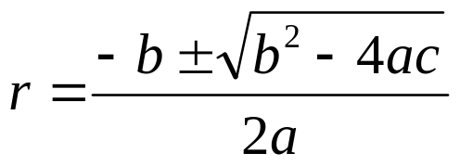

Ch 3.4:
Repeated Roots; Reduction of Order
Recall our 2nd order linear homogeneous ODE
where a, b and c are constants.
Assuming an exponential soln leads to characteristic equation:
Quadratic formula (or factoring) yields two solutions, r₁ & r₂:
When b² – 4ac = 0, r₁ = r₂ = -b/2a, since method only gives one solution:

Slide 2
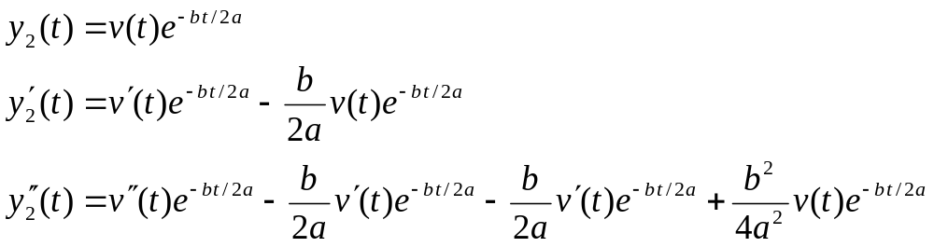
Second Solution: Multiplying Factor v(t)
We know that
Since y₁ and y₂ are linearly dependent, we generalize this approach and multiply by a function v, and determine conditions for which y₂ is a solution:
Then

Slide 3

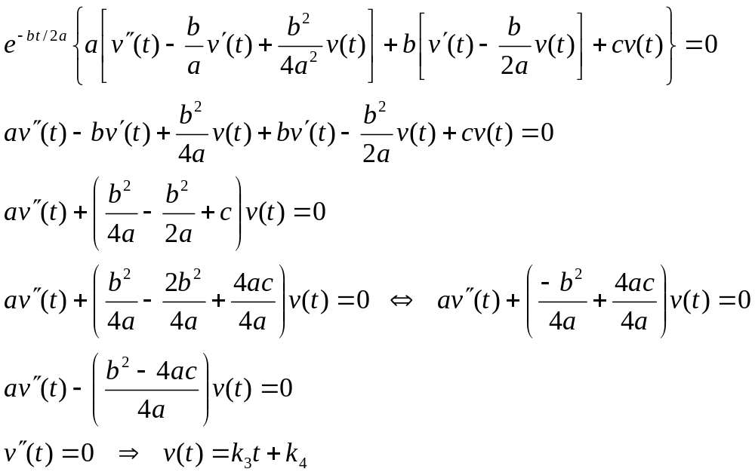
Finding Multiplying Factor v(t)
Substituting derivatives into ODE, we seek a formula for v:

Slide 4

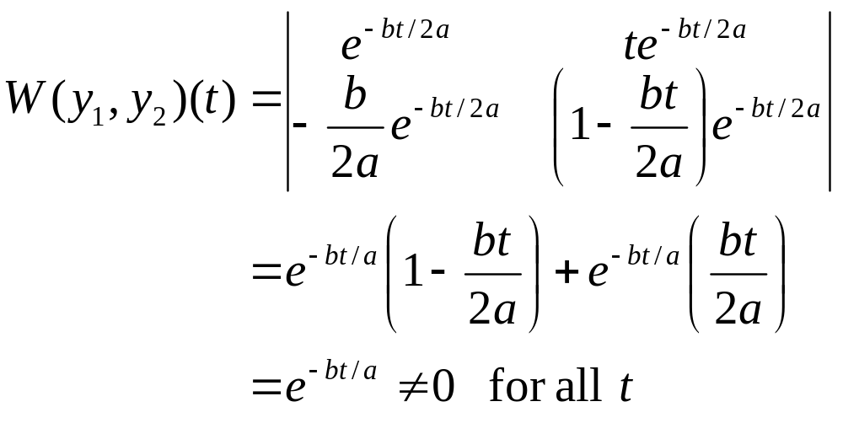

Wronskian, Fundamental Solutions, and General Solutions
Thus, two special solutions found:
The Wronskian of the two solutions is
Thus y₁ and y₂ form a fundamental solution set for equation.
The general solution is

Slide 5

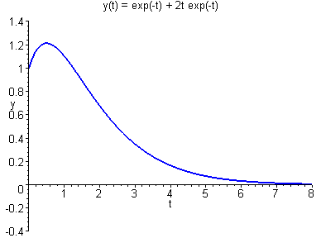
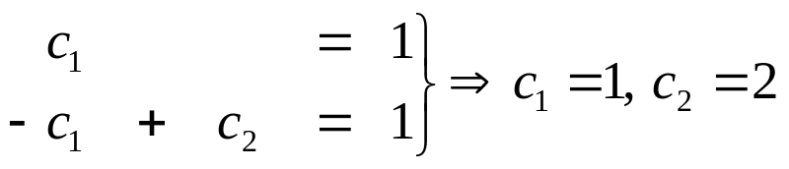

Example 1
Consider the initial value problem
Assuming exponential soln leads to characteristic equation:
Thus the general solution is
Using the initial conditions:
Thus

Slide 6

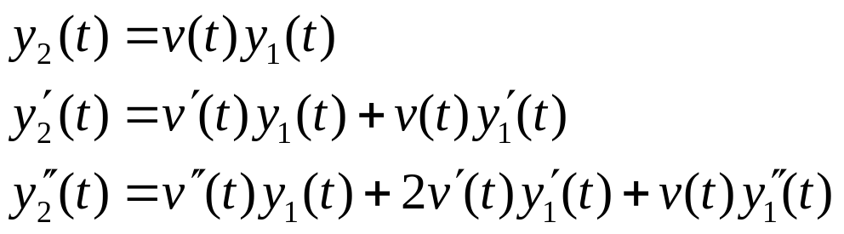

Reduction of Order
The method used so far in this section also works for equations with nonconstant coefficients:
That is, given that y₁ is solution, try y₂ = v(t)y₁:
Substituting these into ODE and collecting terms,
Since y₁ is a solution to the differential equation, this last equation reduces to a first order equation in v′ :

Slide 7
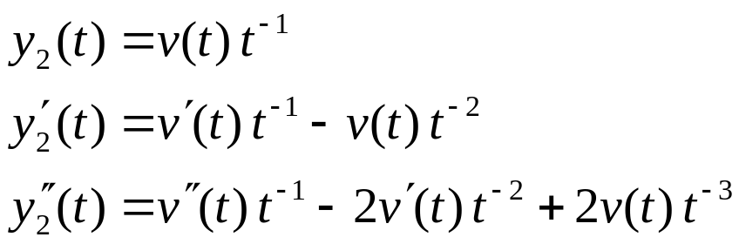
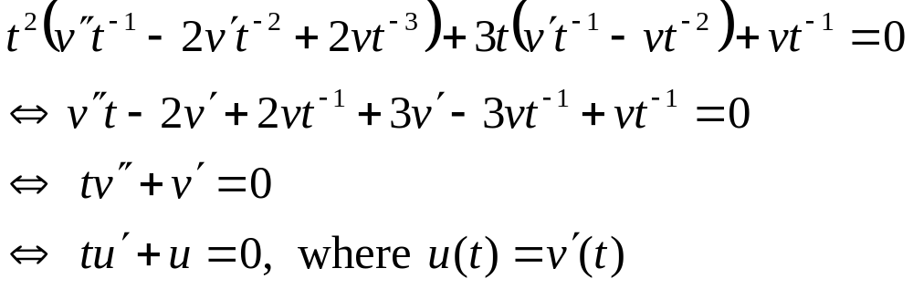
Example 4: Reduction of Order (1 of 3)
Given the variable coefficient equation and solution y₁,
use reduction of order method to find a second solution:
Substituting these into ODE and collecting terms,

Slide 8

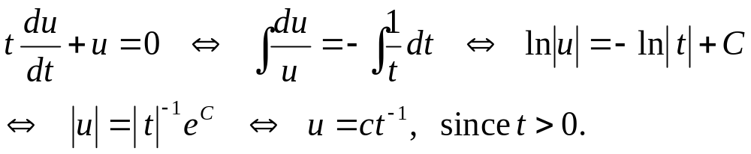
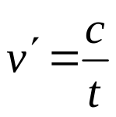

Example 4: Finding v(t) (2 of 3)
To solve
for u, we can use the separation of variables method:
Thus
and hence

Slide 9

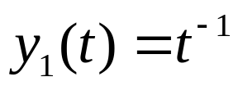


Example 4: General Solution (3 of 3)
We have
Thus
Recall
and hence we can neglect the second term of y₂ to obtain
Hence the general solution to the differential equation is

